Slide 1
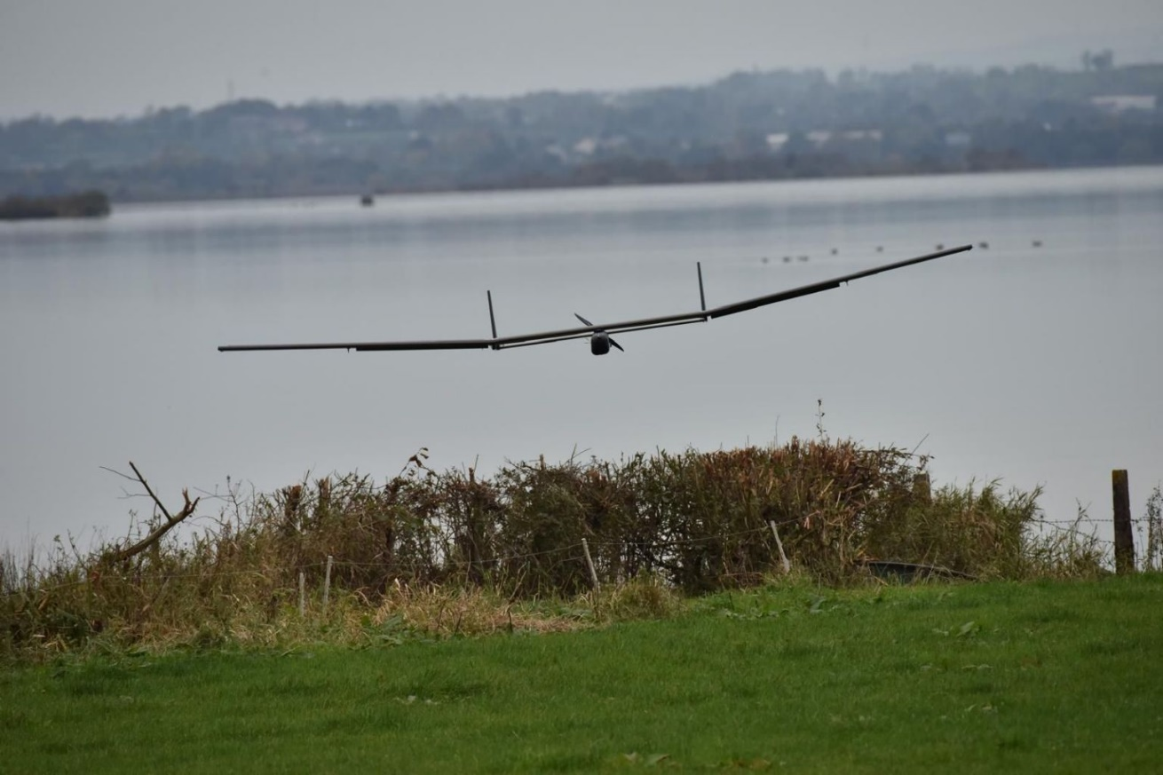
Case Study: Project RESCUE
Resilience and Emergency Services Coordination Using Enabled-drones (RESCUE) project designed to deliver a Somerset-based environmental monitoring and resilience service using drones.
Emergency Response: Assess and design drone-based solutions, including operational concepts, for data collection, rescue support, and monitoring during environmental emergencies in Somerset.
Collaboration & Data Sharing: Develop frameworks for multi-agency data sharing and explore service provision models to ensure effective use of drone intelligence.
Economic Opportunities: Identify regional growth potential from adopting drone technologies and supporting services.

